Slide 1
Disjoint Set ＆
Minimum Spanning Tree

Slide 2
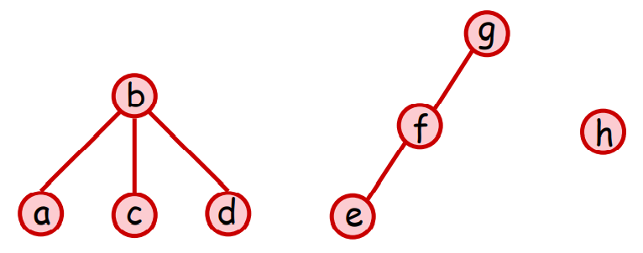
DSU
maintain disjoint set by a forest
each element has its parent
each set is a seperate rooted tree
the representative of each set is the root of tree
example: { {a, b, c, d}, {e, f, g}, {h} }

Slide 3
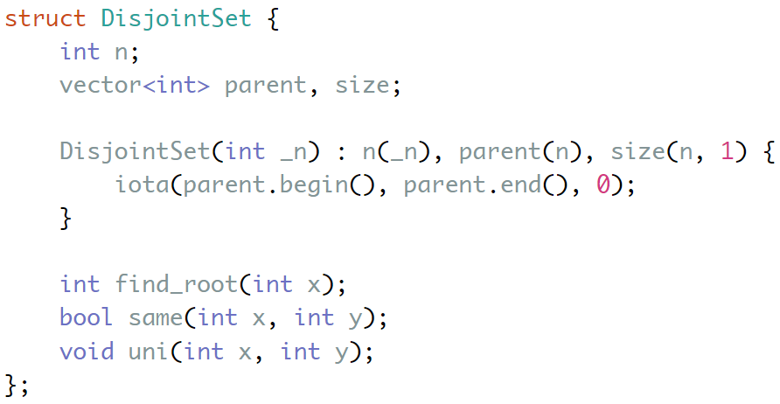
DSU- struct declaration
index | 0 | 1 | 2 | 3 | 4
parent | 0 | 1 | 2 | 3 | 4
size | 1 | 1 | 1 | 1 | 1

Slide 4
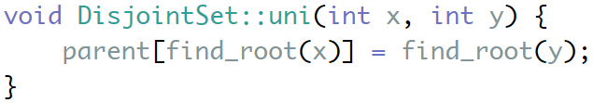
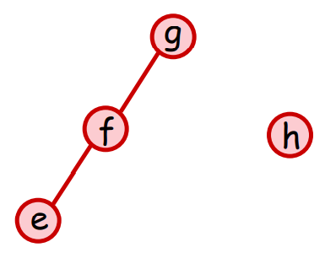
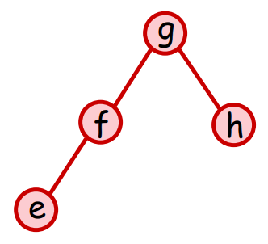
DSU- union()
uni(f, h)

Slide 5
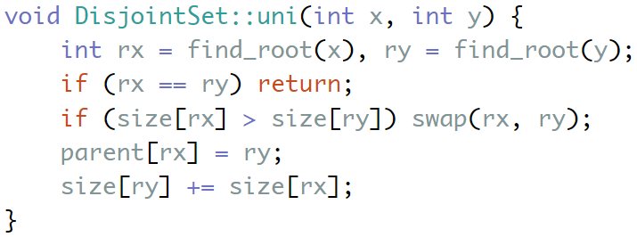
DSU- optimization: union by size
Would the size of each element correct?

Slide 6
DSU- struct declaration
Only the size of each rooted tree’s root is correct, but it is enough.
index | 0 | 1 | 2 | 3 | 4
parent | 0 | 1 | 2 | 3 | 4
size | 1 | 1 | 1 | 1 | 1

Slide 7
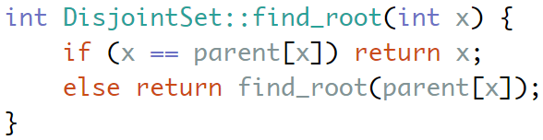
DSU- find_root()

Slide 8
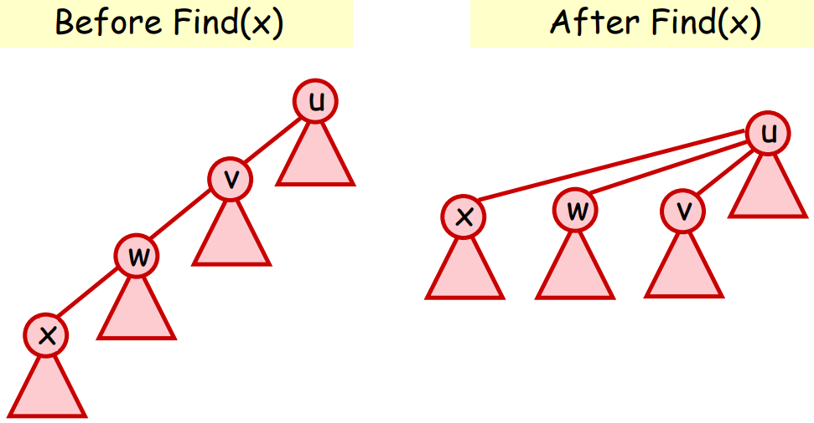
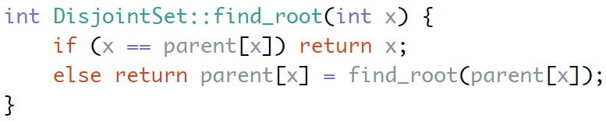
DSU- optimization: path compression

Slide 9
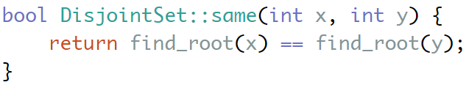
DSU- same()

Slide 10


Time Complexity
m operations:
m operations:
m operations:
(with both)
(with Union by size Only) (why?)
(with Path Compression Only)

Slide 11
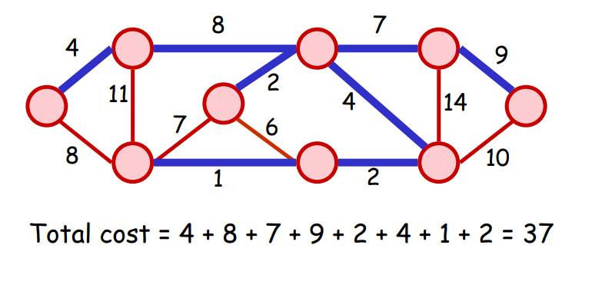
Minimum Spanning Tree
Let G = (V,E) be an undirected, connected graph
A spanning tree of G is a tree, using only edges in E, which connects all vertices of G

Slide 12
Minimum Spanning Tree
Assume each of the edges have weight
A MST of G is spanning tree such that the sum of edge weights is minimized

Slide 13
Minimum Spanning Tree
We try to implement the Kruskal’s Algorithm
Time Complexity: O(ElogE)
use Disjoint Set!!!

Slide 14
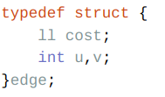

Kruskal’s Algorithm - Preprocess

Slide 15
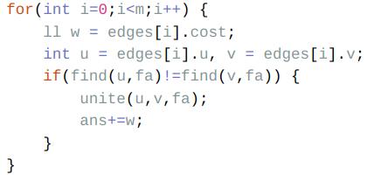
Kruskal’s Algorithm - Adding Edge
add from least-costing edge
tree -> no-cycle
if insert edge (u, v) forms a cycle, skip it(check by DSU)

Slide 16
in class sample codes
Path Compression + Union By Size:
http://codepad.org/t2bkzIwA
MST:
http://codepad.org/SfbFwz8z

